Slide 1



SUPPLY CHAIN ANALYTICS- CAPSTONE PROJECT

Slide 2


agenda
Objective
Backgrounds
Key Insights
Recommendations
Appendix
Data Methodology
Assumptions

Slide 3
Objectives
To understand the key metrics regarding inefficient production and to build a smart live monitoring system.
To identify the top - performing and the worst – performing equipments.
To understand payload carrying capacity of the equipments.

Slide 4
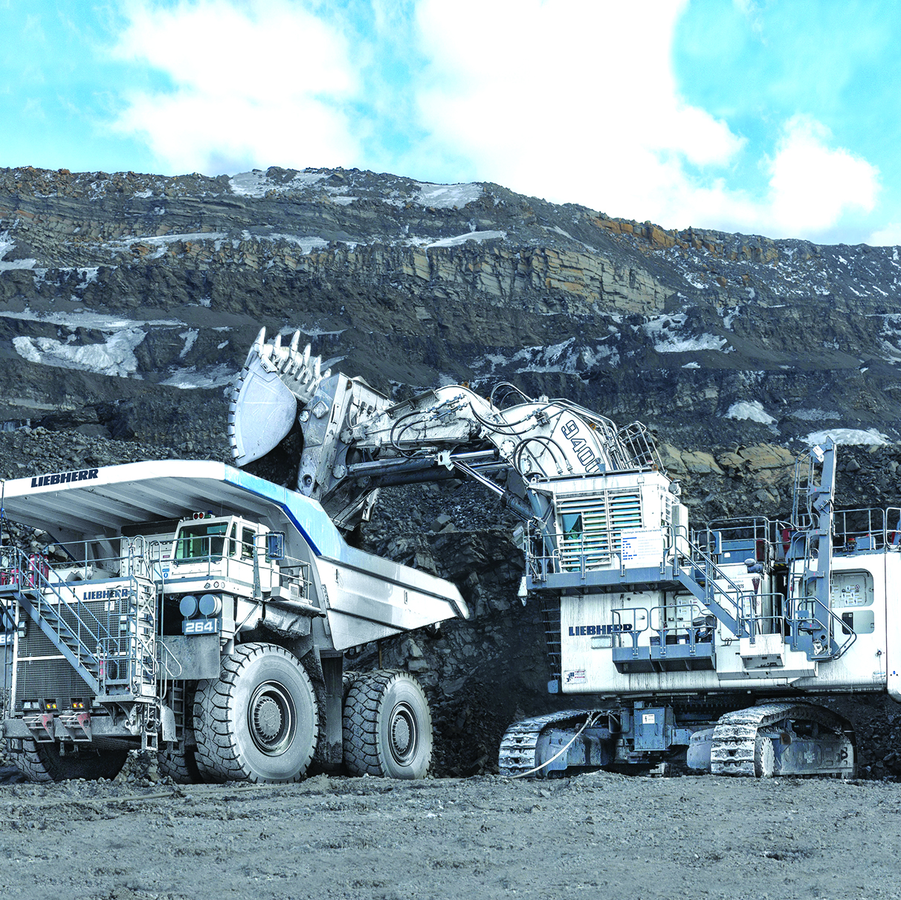
Background
Client is facing problems of inefficient production and is losing customers’ trust .
There is no surge in demand yet they are unable to meet the requirements .
They require a smart live monitoring system to keep track of production.

Slide 5

Key Insights

Slide 6
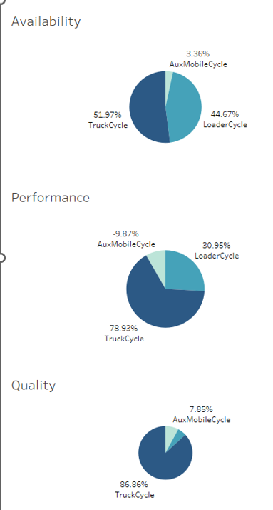

Overall Equipment Effectiveness
While seeing the pie chart, it’s evident that Trucks are the most efficient from all the mining equipment’s.
Availability takes into account “downtime losses” which comprises any events that stopovers planned production for a considerable length of time. Trucks have less down time and are available for operations for more time when compared to other equipment.
Performance takes into consideration “speed loss”, which includes any reasons that cause the equipment to run less than the maximum possible speed planned. Trucks deliver high performance than others.
Quality takes into account “product loss”. Trucks have a higher quality quotient.

Slide 7
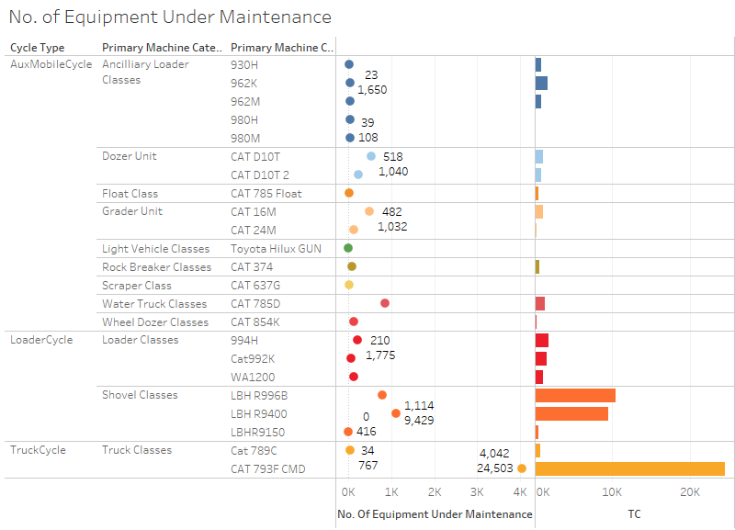



Equipment Availability
A key element in our operation is the equipment that is undergoing maintenance. We must make certain that our tools are always on the ground.
Trucks and loaders spend the least time off the ground, according to this graph, whereas dozer units need extensive maintenance.

Slide 8
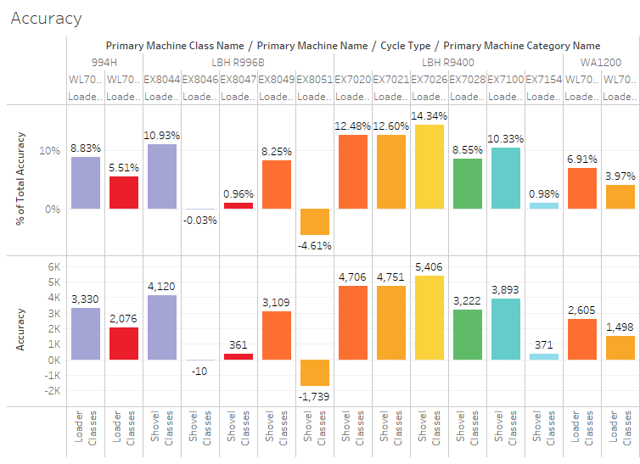
Efficiency and Accuracy
Insights:
EX8049, EX8044 and EX7026 having the maximum Loading Efficiency in Shovel Classes in Loader Cycle.
DZ2007 and DZ2224 having the minimum Loading Efficiency in Wheel Dozer Classes.
EX 7026, EX7020 and EX 7021 having the highest accuracy.

Slide 9
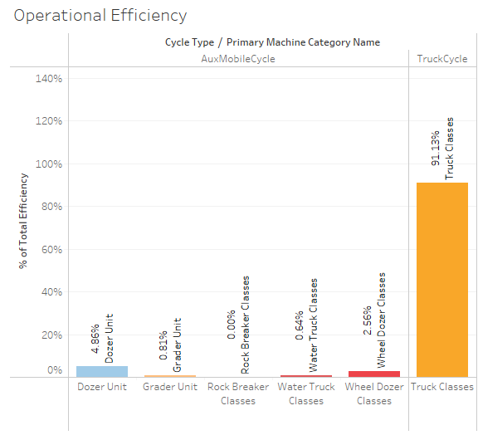
Operational Efficiency
Any firm must operate efficiently to succeed.
Insights:
The least effective of the bunch are the classes for Rock Breakers Classes.
Equipment in the truck classes is the most effective.
Dozer Unit has the total efficiency of 4.68% which is higher among other classes.

Slide 10
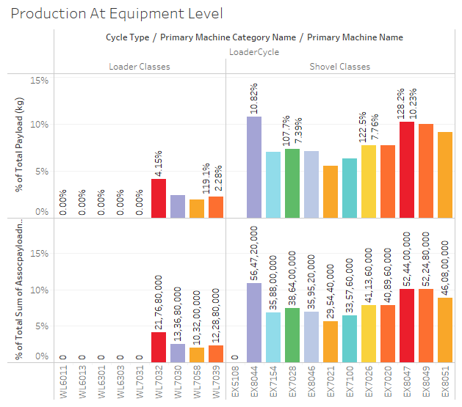
Productivity
Insights :
Shovel Classes transfer the maximum amount of ores.
EX8044, EX8049 are highly effective in transferring payload
and are trending at above 10%.

Slide 11
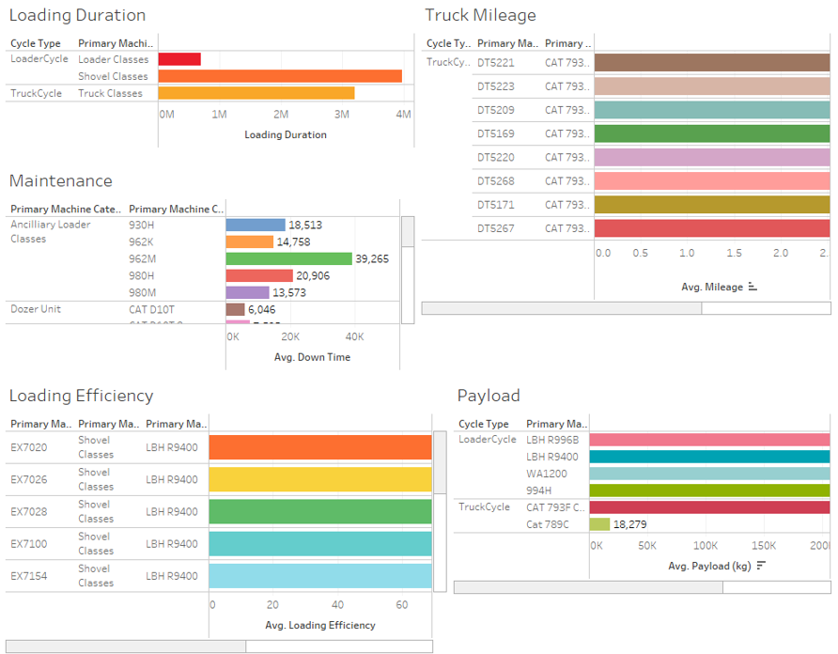
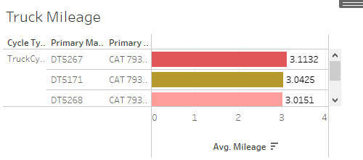
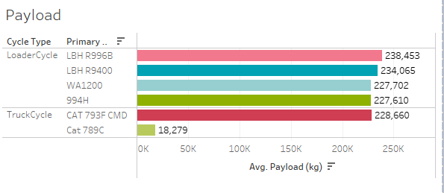
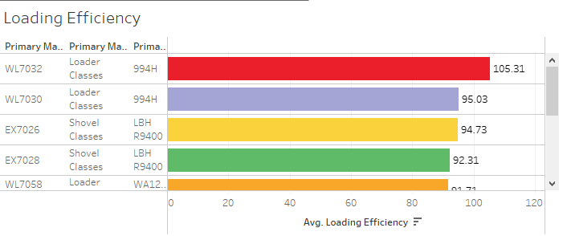
Performance
Insights:
DT5267 has the best mileage.
994H, LBH R996B and LBH R9400 has the least maintenance.
Loader WL 7032 and Shovel EX 7026 have the highest loading efficiency in their respective classes.
Loaders have capability of high payload, and in trucks CAT 793F CMD has the ability to take more ores.

Slide 12

Recommendation
Replace less productive equipment with more productive equipments from the same category.
Given the expense of fuel, trucks with a larger payload and mileage should be chosen.
Lower-quality equipment should be replaced because it has more downtime.
To cut down on maintenance time, there should be on-field maintenance.
In order to decrease the loading and waiting times, we should increase the number of loaders.

Slide 13

Appendix
.
Data Methodology
Assumptions

Slide 14
Data Methodology
Data was cleaned in Jupyter Notebook, analysis was done on MySQL Workbench 8.0 and all visualizations on Tableau Public.
Some outliers were replaced median value from the dataset.
Stored procedures were made on MySQL for cycle data, location/movement data, delay data, OEE etc.
Some calculated fields were created on Tableau e.g. OEE, performance etc.

Slide 15
Assumptions
Net Available Time (AT Available Time (iMine) - Idle Duration).
Net Operating Time (OPERATINGTIME (CAT) - Idle Duration).
Equipments with downtime are assumed to have gone through maintenance.

Slide 16




Meet Our Team
Avni Shrivastava
Kush Giri
Roshani Shrivastava

Slide 17
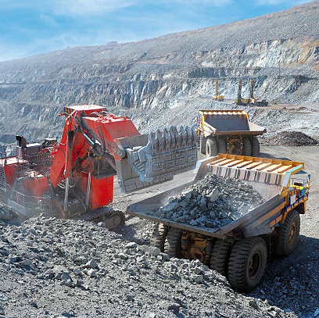
Thank you

